Slide 1
Foundations of Statistical Natural Language Processing Christopher D. Manning Hinrich Schütze
Chap. 6 Statistical Inference: n-gram Models over Sparse Data

Slide 2
Index
Introduction
Forming Equivalence Classes
Statistical Estimators
Combining Estimators
Conclusions

Slide 3
Introduction
pp. 4 - 5

Slide 4
Language Modeling
The goal of Statistical NLP is to set the appropriate Language Model.
The purpose of Language Modeling is to predict the next word from the previous words.
ex.) n-gram models (Today’s main topic)
Notes:
This task is fundamental to speech or optical character recognition, and is also used for spelling correction, handwriting recognition, and statistical machine translation.

Slide 5
Introduction
This chapter divides into 3 areas.
dividing the training data into equivalence classes
finding a good statistical estimator for each class
combining multiple estimators

Slide 6
Forming Equivalence Classes
pp. 6 - 9

Slide 7
Classification Task
In order to do inference about one feature, we need to predict the target feature on the basis of various classificatory features.
When doing this, we effectively divide the data into equivalence classes
How to make them?
A
B
C
?
classificatory features
target feature
Notes:
Dividing the data into many categories gives us greater discrimination, but if we use a lot of categories and they may contain no or a very small number of training instances, then we will not be able to do statistically reliable estimation of the target feature.

Slide 8
n-gram models
The n-gram models predict the next word on the basis of previous words. It can be stated using probability function P:
P(W_{n},lW₁,...,W_{n-1})
The concept of this model is that the last few words affects the next word.
People usually use n = 2 or 3 and these are usually referred to as a bigram and a trigram, respectively.
Notes:
Dividing the data into many categories gives us greater discrimination, but if we use a lot of categories and they may contain no or a very small number of training instances, then we will not be able to do statistically reliable estimation of the target feature.

Slide 9
Column: Why not use four-gram?
If we assume that a speaker is staying within a vocabulary of 20,000 words, then we get the estimates for numbers of parameters shown bellows.
The number of parameters of four-gram model is useful, but well not be practical, too large to treat.
For this reason, n-gram systems currently usually use bigram or trigrams.
Notes:
Dividing the data into many categories gives us greater discrimination, but if we use a lot of categories and they may contain no or a very small number of training instances, then we will not be able to do statistically reliable estimation of the target feature.

Slide 10
Statistical Estimators
pp. 11 - 23

Slide 11
Statistical Estimators 1/2
After forming equivalent classes, the second goal is finding out how to derive a good probability estimate for the target feature based on certain categories.
How to make them?
A
B
C
?
P(A) = 0.1
P(B) = 0.7
P(C) = 0.2
classificatory features
target feature

Slide 12
Statistical Estimators 2/2
Maximum Likelihood Estimation (MLE)
Laplace’s law
Jeffreys-Perks law (Expected Likelihood Estimation : ELE)
Held out estimation
Cross-validation (deleted estimation)
Good-Turing estimation

Slide 13
Maximum Likelihood Estimation (MLE) 1/2
Example: In a certain corpus, the authors found 10 training instances of the words comes across, and of those, 8 times they were followed by as, once by more and once by a.
...
come across as ... come across a ... come across as ... come across as ... come across more ... come across as ... come across as ... come across as ... come across as ... co me across as ...
...

Slide 14
Maximum Likelihood Estimation (MLE) 2/2
What probability estimates we should use for estimating the next word?
The obvious answer is to suggest using the relative frequency.
This estimate is called the maximum likelihood estimate (MLE).
MLE cannot find unseen events.

Slide 15
Laplace’s law
In order to find unseen events, Laplace’s law is used.
This process is often referred to as adding one, and has the effect of giving a little bit of the probability space to unseen events.
If the test data is small, Laplace’s low causes overestimation.
Notes:
----- 会議メモ (2013/12/06 14:43) -----
overestimation : 過学習

Slide 16
Jeffreys-Perks law (ELE)
Lidstone’s law, where we add not one, but some (normally smaller) positive value λ:
The most widely used value for λ is ½. When λ = ½, we call it Jeffreys-Perks law, or Expected Likelihood Estimation (ELE)

Slide 17
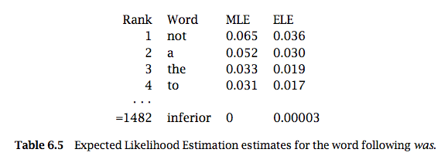
Column: Applying these methods
The test data that we will use is Jane Austen’s novel, freely available, and too large.

Slide 18
Held out estimation 1/3
Held out data is the test data.
Training data is part of the test data.
The concept of Held out estimation is that how often bigrams that appeared r times in the training data tend to turn up in the Held out data.

Slide 19
Held out estimation 2/3
For each n-gram, w₁ . . . w_{n}, let:
N_{r} is the number of n-grams with frequency r. Now let:
T_{r} is the total number of times that all n-grams that appeared r times in the training text appeared in the held out data.

Slide 20
Held out estimation 3/3
Then the average frequency of those n-gram is T_{r}/N_{r} and so an estimate for the probability of one of these n-grams is:

Slide 21
Column: test data and training data
data set
training data
test data

Slide 22
Cross-validation (deleted estimation)
Suppose we let N_{r}ª be the number of n-grams occurring r times in the a^{th} part of the training data, and T_{r}^{ab} be the total occurrences of those bigrams from part a in the b^{th} part.
This is named Cross-validation or deleted estimation.
0
0
0
1
1
1

Slide 23
Good-Turing estimation
Where the S(r) is the smoothed values (not mentioned thoroughly).
Good-Turing estimation works well when r is small value.

Slide 24
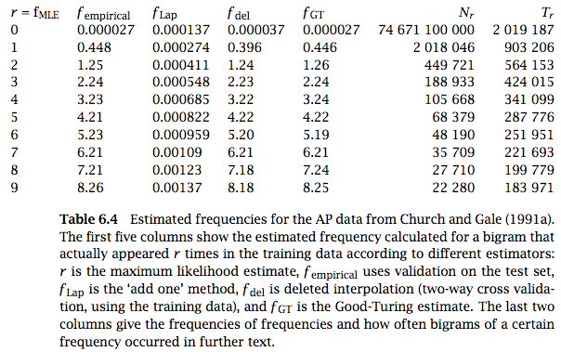
Column: Estimated frequencies

Slide 25
Combining Estimators
pp. 28 - 31

Slide 26
Combining Estimators
In this section we consider the more general problem of how to combine multiple probability estimates from various different models.
Simple linear interpolation
Katz’s backing-off
General linear interpolation

Slide 27
Simple linear interpolation
For interpolating n-gram language models, the most basic way to do this is:
The weights may be set by hand, in general one wants to find the combination of weights that works best.
This can be done automatically by a simple application of the Expectation Maximization (EM) algorithm.

Slide 28
Katz’s backing-off
The estimate for an n-gram is allowed to back off through progressively shorter histories:
Back-off models are sometimes criticized because their probability estimates can change suddenly on adding more data.
Nevertheless, they are simple and in practice work well.

Slide 29
General linear interpolation
In simple linear interpolation, the weights were just a single number, but one can define a more general and powerful model where the weights are a function of the history.

Slide 30
Conclusions
p. 33

Slide 31
Conclusions
A number of smoothing methods are available which often offer similar and good performance figures.
Using Good-Turing estimation and linear interpolation or back-off to circumvent the problems of sparse data represent good current practice.

